Slide 1
Readmitted Prediction Capstone
Sharon Li

Slide 2
CONTENT
Introduction
Data Description
Correlation Analysis
Models & Conclusion

Slide 3
Introduction
The data set is from kaggle: https://archive.ics.uci.edu/ml/datasets/diabetes+130-us+hospitals+for+years+1999-2008, which contains over 100 thousand data with 49 features, containing variables below:
▲ Detail about patient(gender, age)
▲ Information related with intersaction(pay method, emergency id)
▲ Diagnos(diag1, diag2, diag3)
▲ Different health index for the patient(metformin, repaglinide)
▲ Change of the perscription
▲ Take diabete meds or not
▲ readmitted or not, time length

Slide 4
Data Description
drop column by context:
encounter_id,
patient_nbr,
payer_code,
number_outpatient,
number_inpatient,
number_emergency, num_lab_procedures,
num_procedures,
num_medications
drop column by distribution(extremely imbalance):
max_glu_serum, repaglinide,
nateglinied, chlorproamide,
acetohexamide, race,
tolbutamide, acarbose,
miglitol, troglitazone,
tolazamide, examide,
citoglipton, glyburide-metformin,
glipizide-metformin, glimepiride-pioglitazone, metfomin-rosiglitazone, metformin-pioglitazone

Slide 5
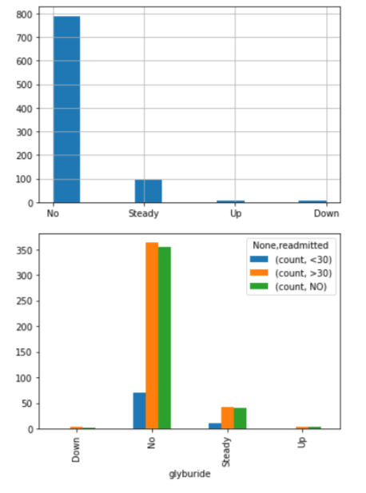
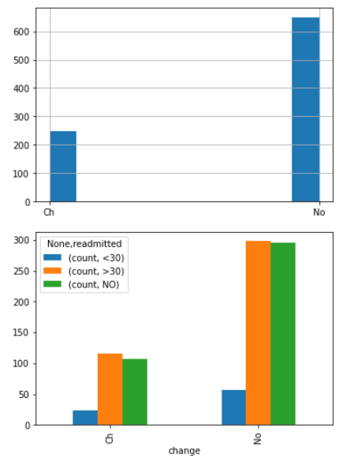
Data Description
Drop column by distribution:
the columns with the same distribution in all the different data

Slide 6
Model & Conclusion
 | Logistic Regression | Random Forest | KNN | SVM | Naive bayes | Decision Tree
accuracy score with training set | 0.54896 | 0.60353 | 1 | 0.53933 | 0.52809 | 1
accuracy score with test set |  |  | 0.22761 |  | 0.4834 | 0.46269
underfitting: Logistic Regression, Random Forest, SVM, Naive Bayes
overfittingL KNN, Decision Tree
Notes:
OK， next I will introduce about our findings on customer profile. The dataset recorded customers information into 5 parts: gender, age, occupation, city, and marital status.
First, in terms of gender, it shows an unexpected result compared with general intuition. Data shows that the males account the main part of customers on Black Friday. Also, the males won in terms of average consumption. A big surprise, right?

Slide 7
Model & Conclustion
According to evaluation results, logistic regression, random forest, SVM, Naive Bayes and XGboost show underfitting with a accuracy score less than 0.7, while KNN and Decision Tree show overfitting on training data set with a high accuracy score at 1 and low accuracy score on test set.
These bad performance of the models may because of the lack of training data, the result could be better with a large sum of data set and less amount of variables.

Slide 8
THANK YOU
FOR WATCHING

